Slide 1
PREDICT
CTR OF AN
EMAIL CAMPAIGN
To Predict The Click Through Rate (CTR) of an email campaign.
Presenter: Mr. Rahul Kumar Singh
Mentor: Analytics Vidya JOB-A-THON - August 2022
Date:07-08-2022

Slide 2
TABLE OF CONTENTS
Problem Statement Understanding
DATA PROCESSING
CONCLUSION & RECOMMENDATION
01
03
05
02
04
DATA UNDERSTANDING
MODEL Building

Slide 3

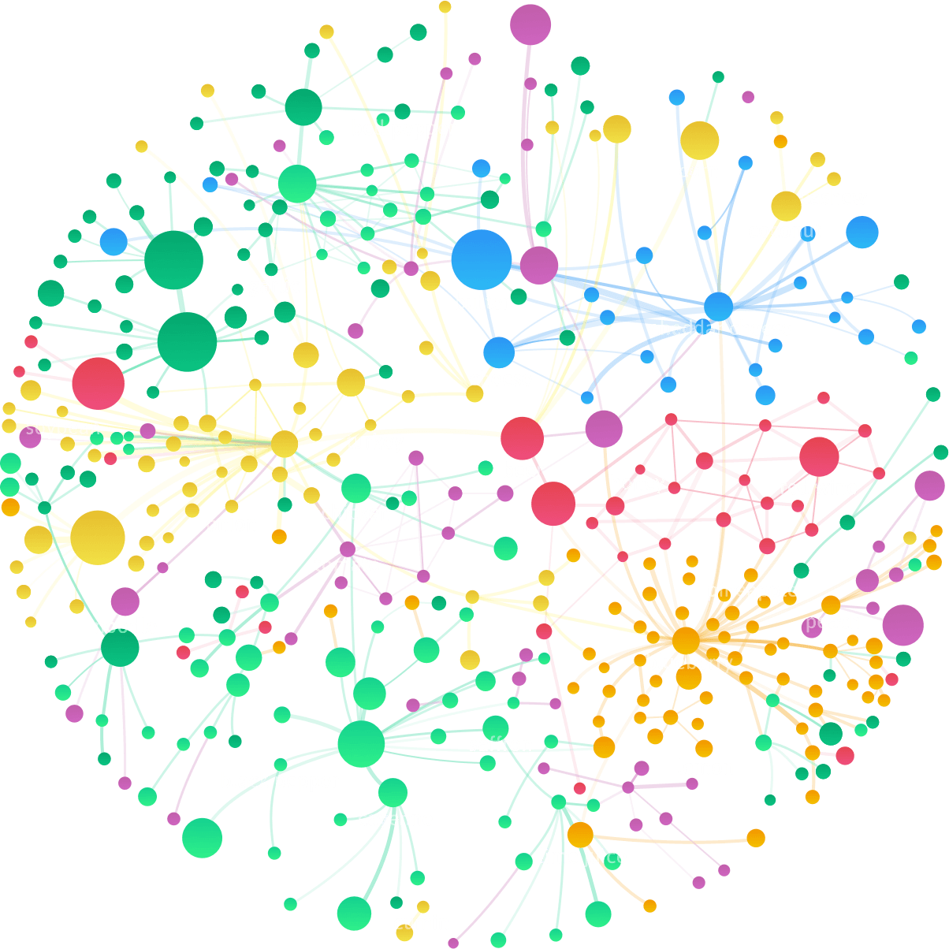
01
PROBLEM
STATEMENT UNDERSTANDING

Slide 4
Most organizations today rely on email campaigns for effective communication with users. Email communication is one of the popular ways to pitch products to users and build trustworthy relationships with them. Email campaigns contain different types of CTA (Call To Action). The ultimate goal of email campaigns is to maximize the Click Through Rate (CTR). CTR is a measure of success for email campaigns. The higher the click rate, the better your email marketing campaign is. CTR is calculated by the no. of users who clicked on at least one of the CTA divided by the total no. of users the email was delivered to.
CTR = No. of users who clicked on at least one of the CTA / No. of emails delivered
CTR depends on multiple factors like design, content, personalization, etc.
* How do you design the email content effectively?
* What should your subject line look like?
* What should be the length of the email?
* Do you need images in your email template?
Business Understanding

Slide 5
Business Understanding
BUSINESS PROBLEM- CLICK RATE REGRESSION BASED ON HISTORY PROVIDED
Business Objective
Business Objective
To build a machine learning-based approach to predict the CTR of an email campaign.

Slide 6

02
Data Understanding

Slide 7
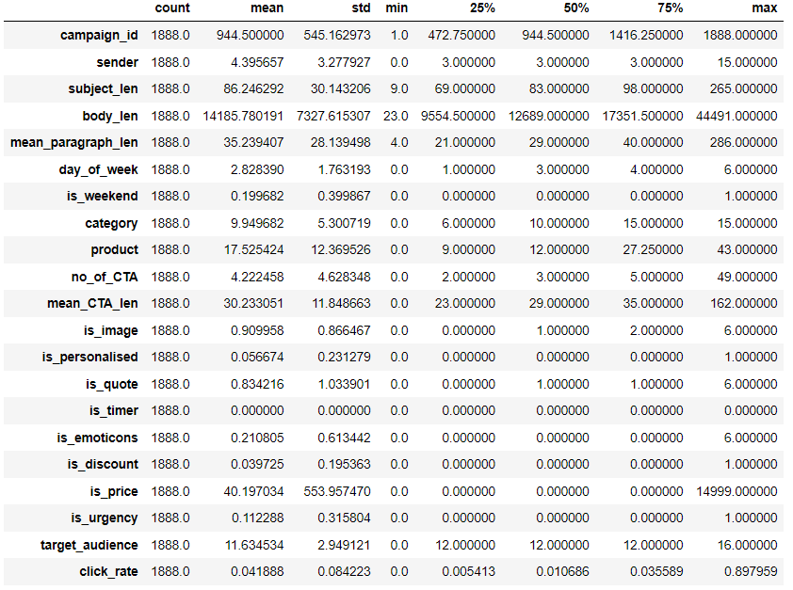
DATA UNDERSTANDING
Loading Data
The dataset consist of 1888 rows.
Statistical summaries
We are seeing a lot of features average are very less and body_len feature average is very high. We need to lower these numbers so it will help in model preparation.
std of body_len and is_price is quite large this shows there must be outliers.
Most of the variables minimums are near zero. We have to be very careful with multicollinearity.
We will drop the is_timer column as there are no data, which means there is no resemblance with other features.
We will encode categorical variable times_of_day with times_of_day_ID and will drop times_of_day.

Slide 8
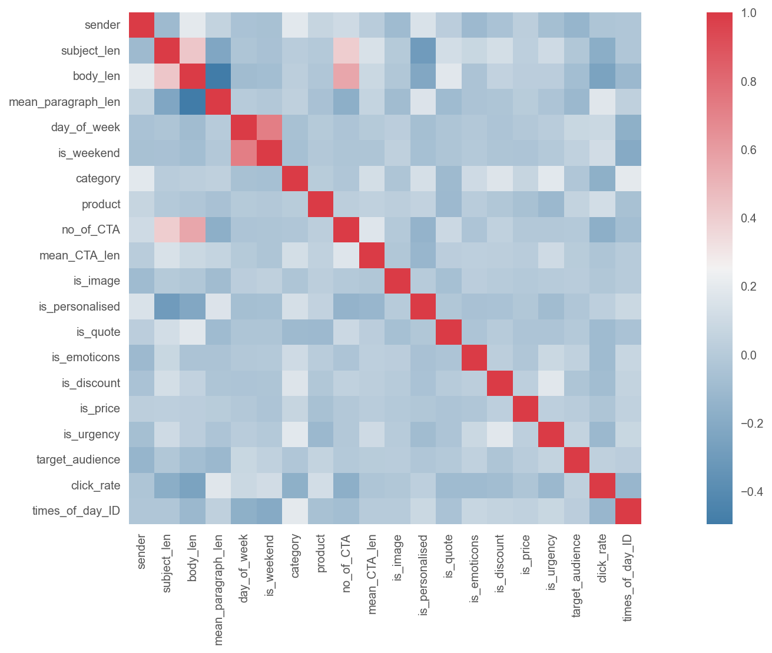
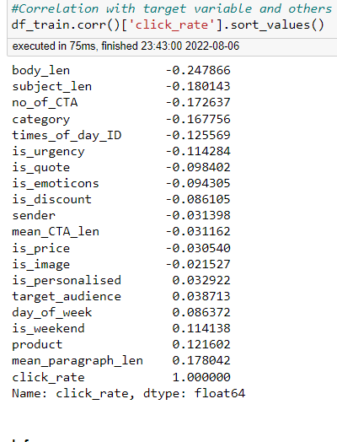
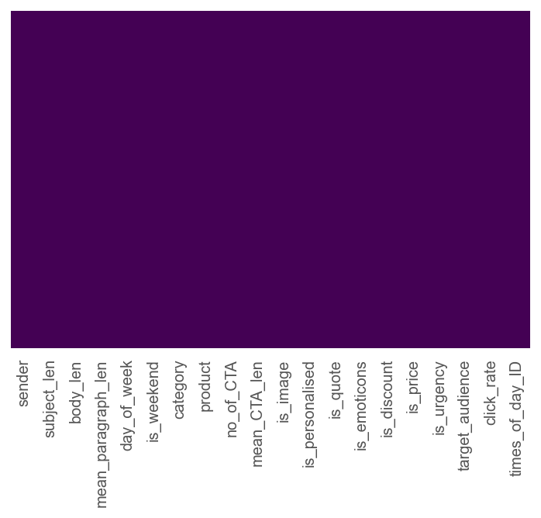
DATA UNDERSTANDING
Inference:
So,we see there is no high correlation with target variables with others but let us check on other variables.
Strong correlation is there between no_of_CTA and body_len, subject_len is moderately correlated with body_len and no_of_CTA.
mean_paragraph_len is highly negative correlated with body_len
There are no null values.

Slide 9

03
DATA
PROCESSING

Slide 10
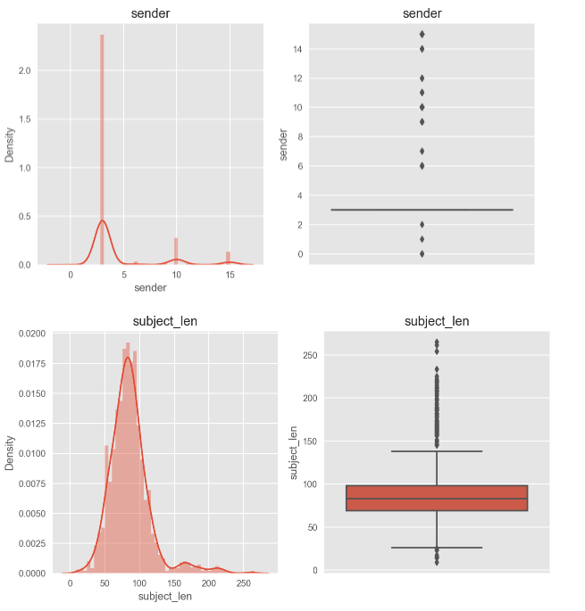
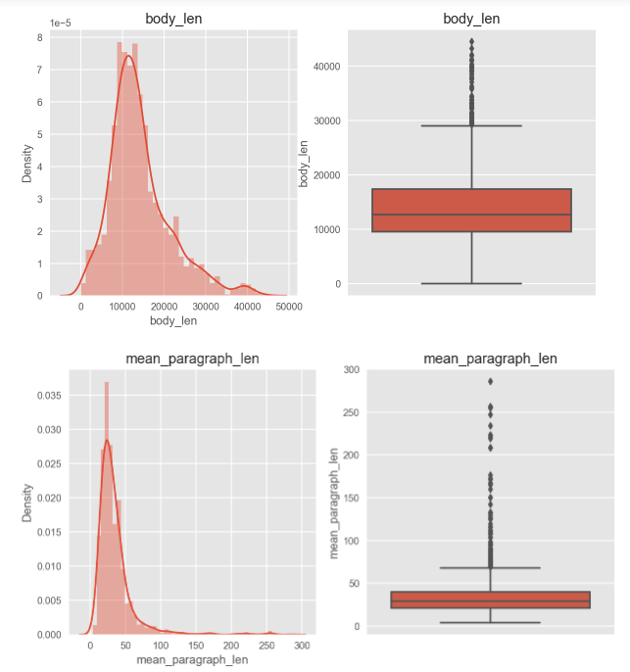
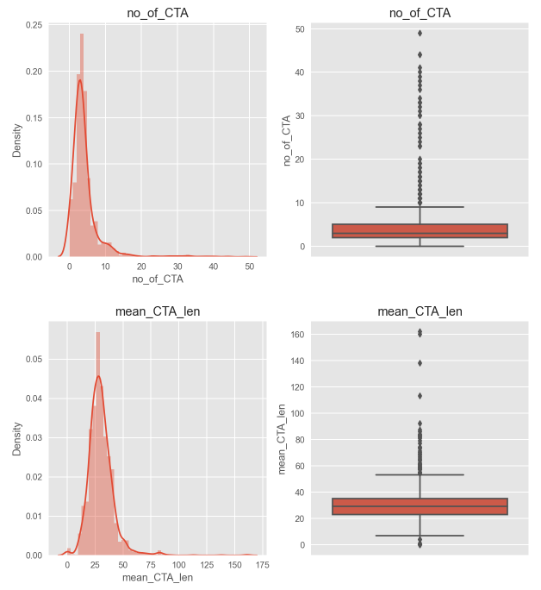
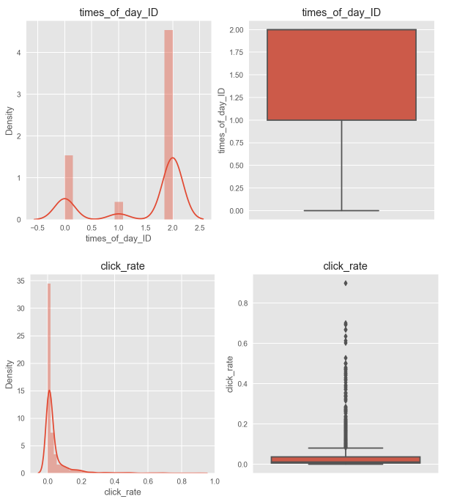
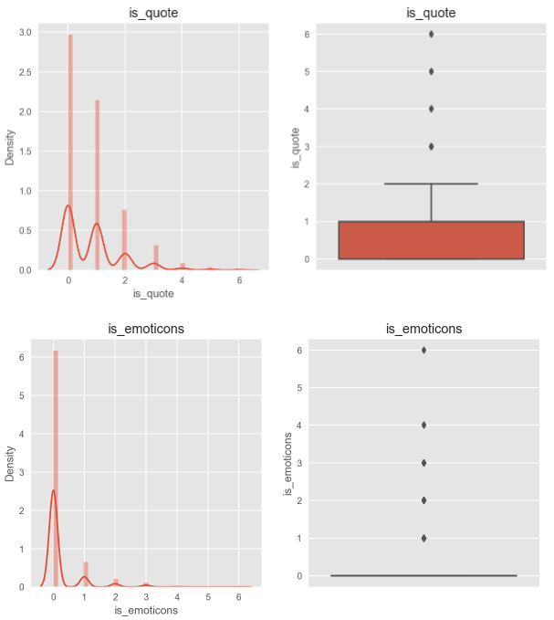
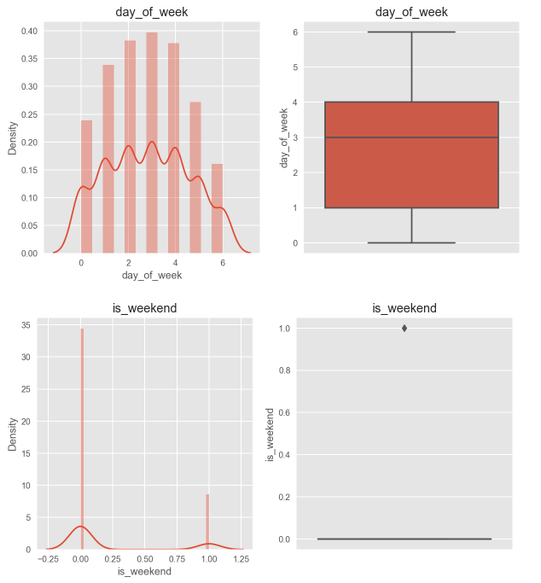
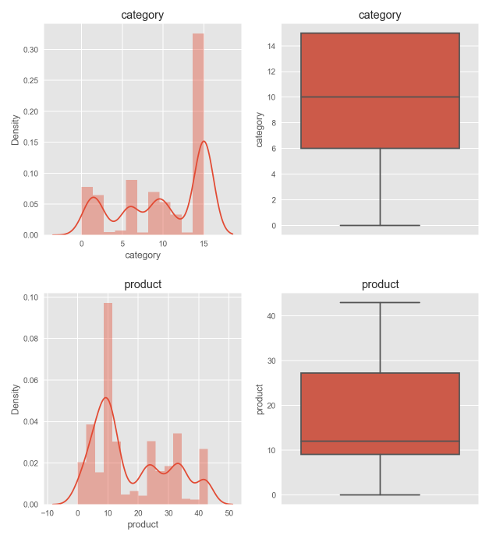
DATA PROCESSING- CHECKING FOR OUTLIERS
Inference:
We have used different types of techniques to visualize outliers on numerical fetures and the results are not good sice all the feature consists of alot of outliers and as the outliers are more we cannot remove them so we will try different techniques to eliminate them.
The distribution plot and qqplot shows the variables are not normalliy distributed.
Most of them have a positive skewness..
Add Text
Simple PowerPoint Presentation

Slide 11
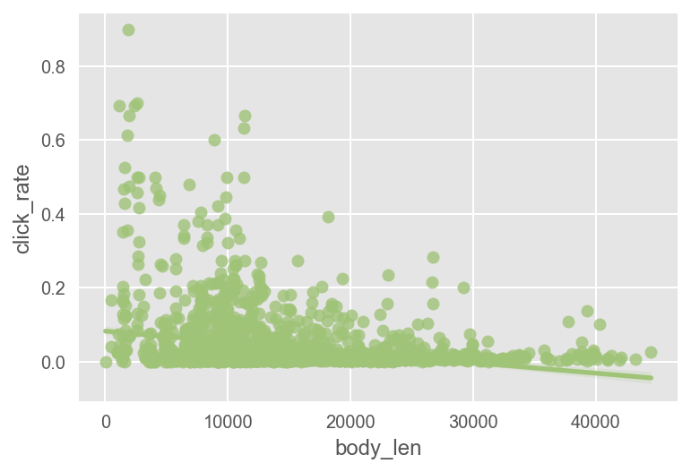
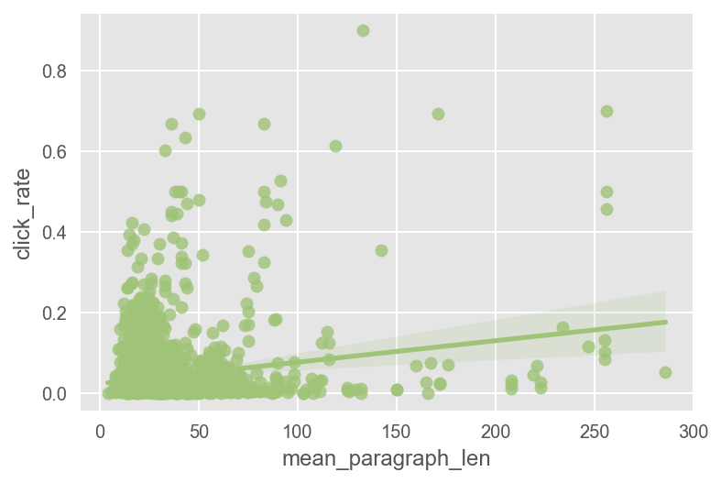
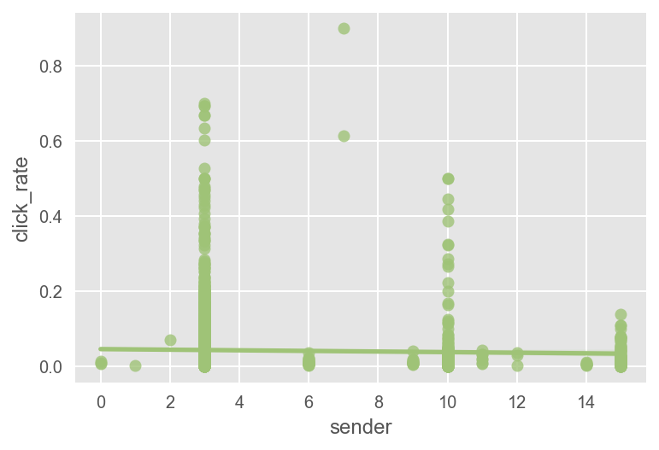
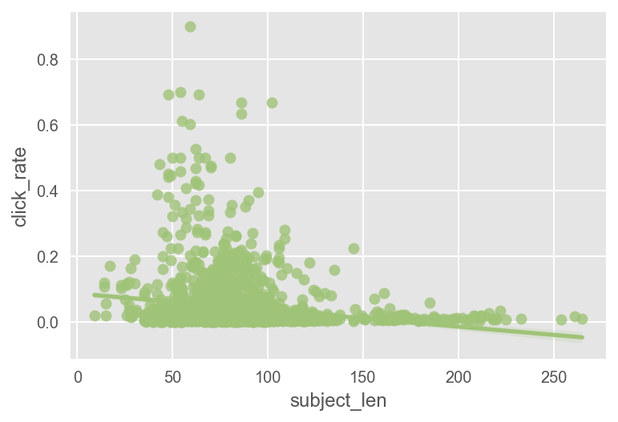
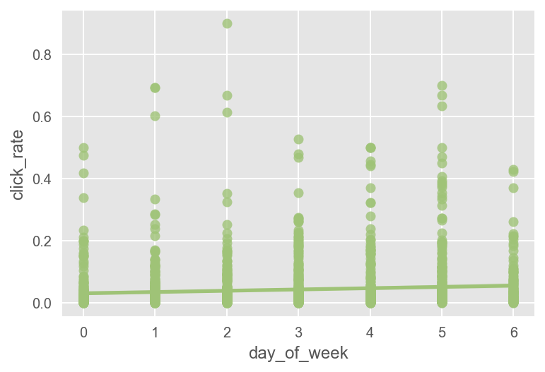
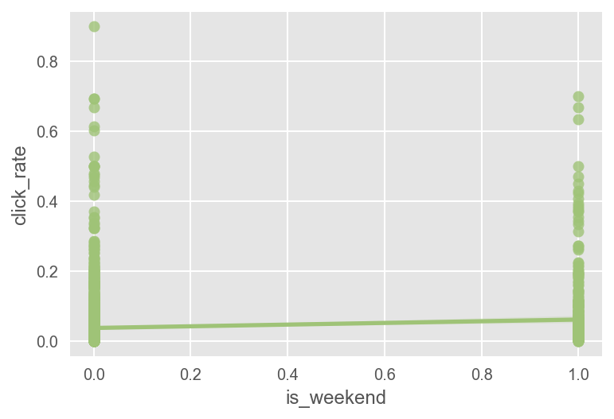
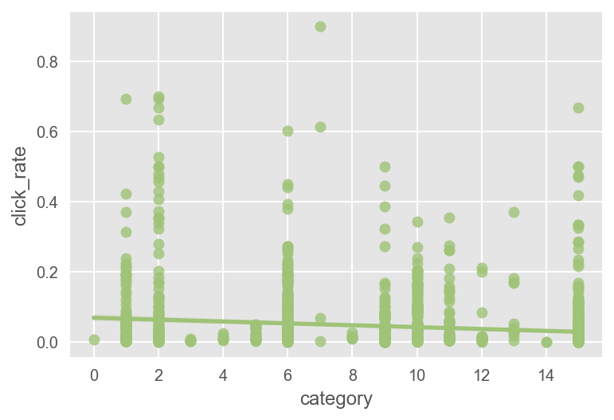
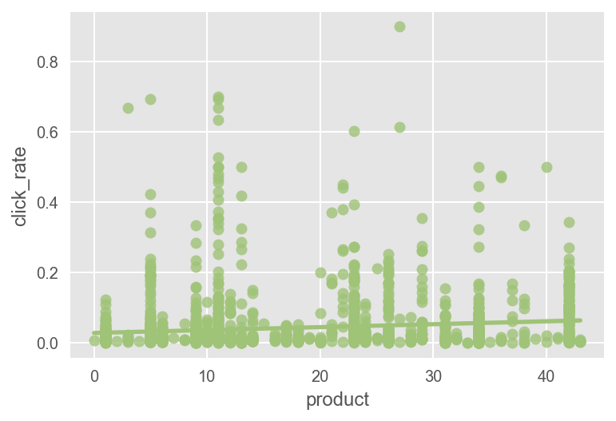
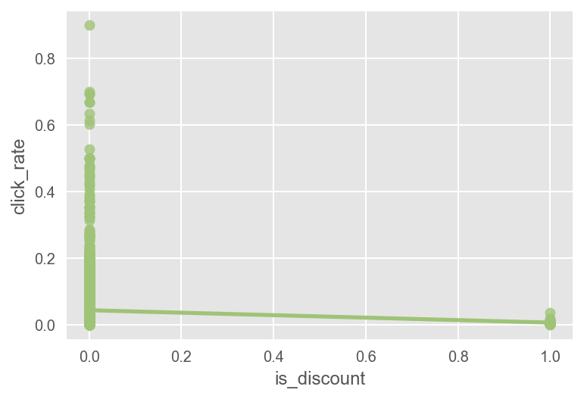
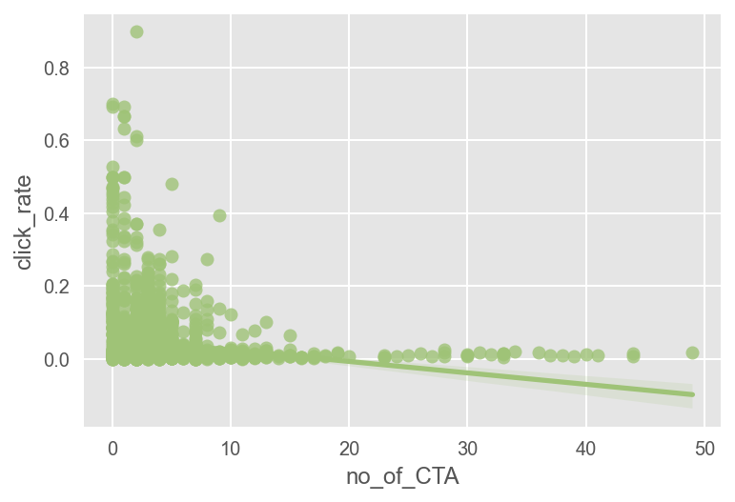
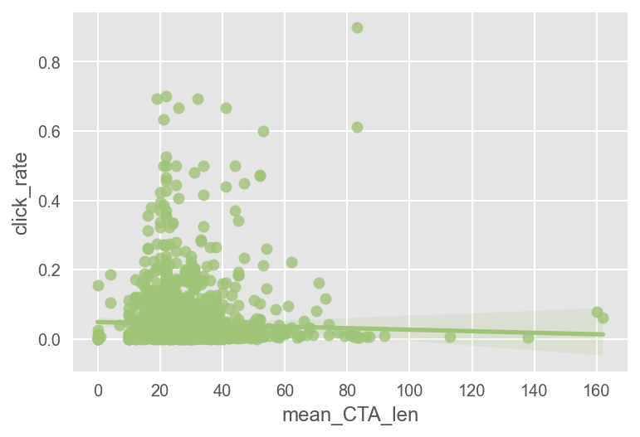
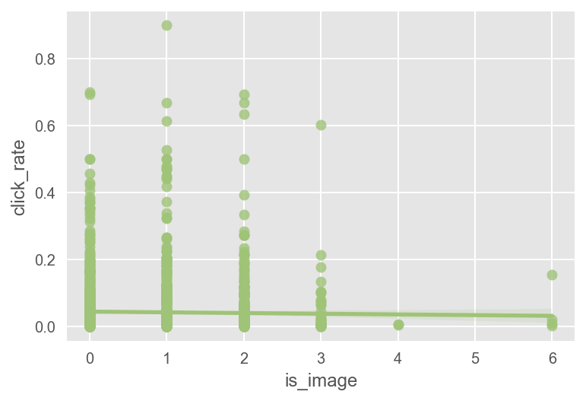
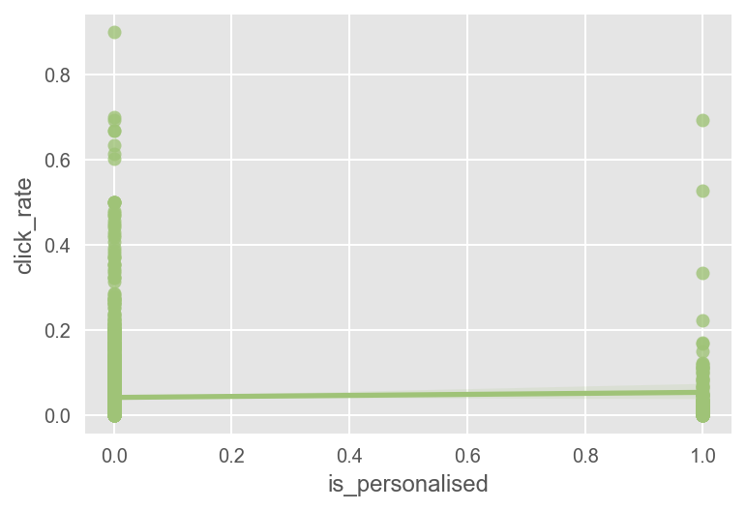
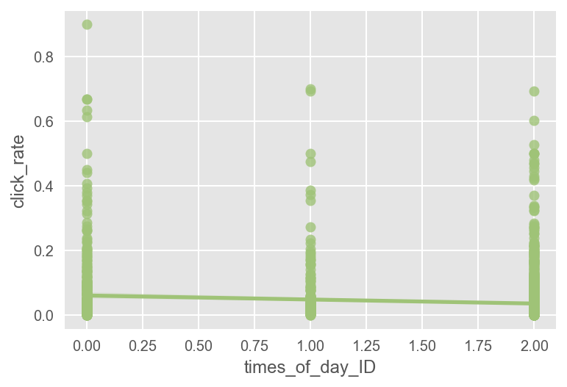
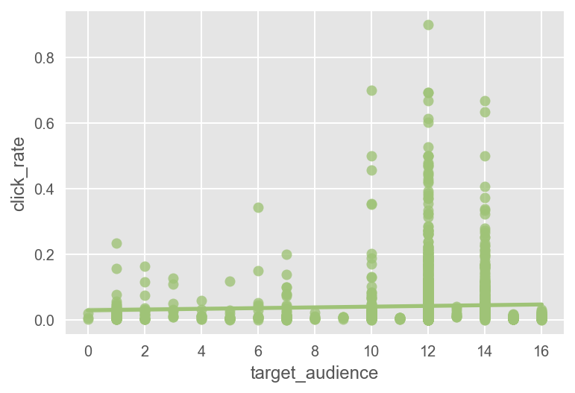
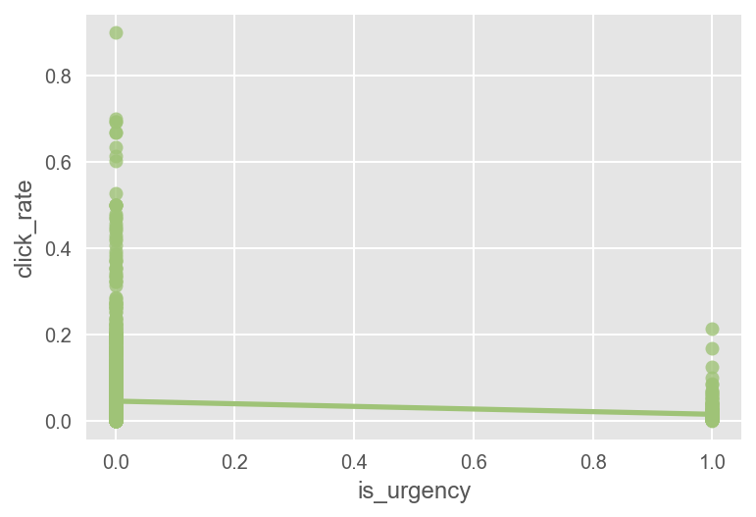
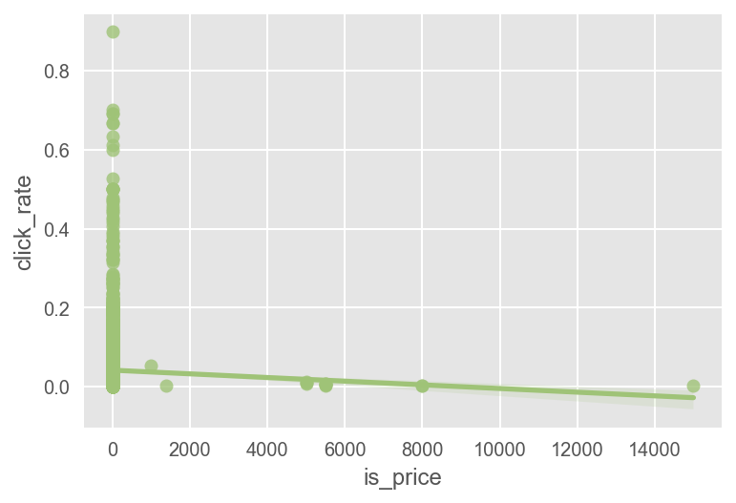
DATA PROCESSING- FEATURE EXPLORATION ON REGPLOT
Inference:
From regplot, we have compare each variables with the target variable. Only 'mean_paragraph_len' & 'product' are giving linear relation as it increases.'sender','day_of_week','is_weekend','is_image','is_personalised'& 'mean_CTA_len' is uniform to our target variable. Rest all other variables are showing negative relation with target variable.

Slide 12
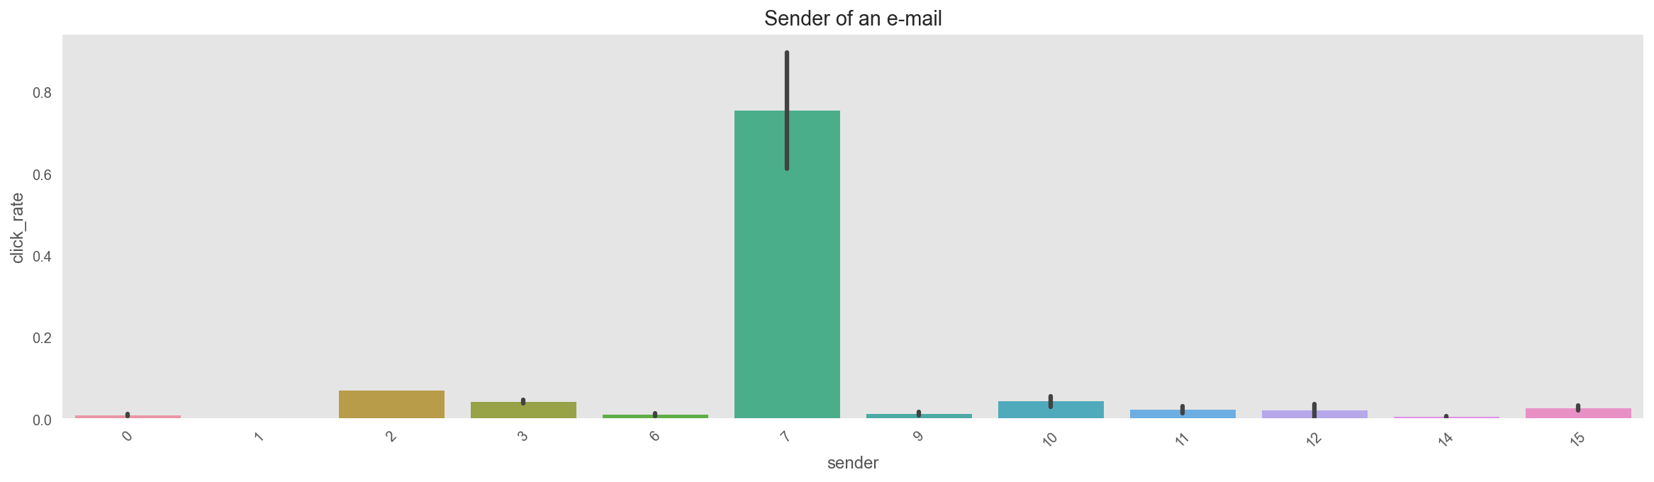
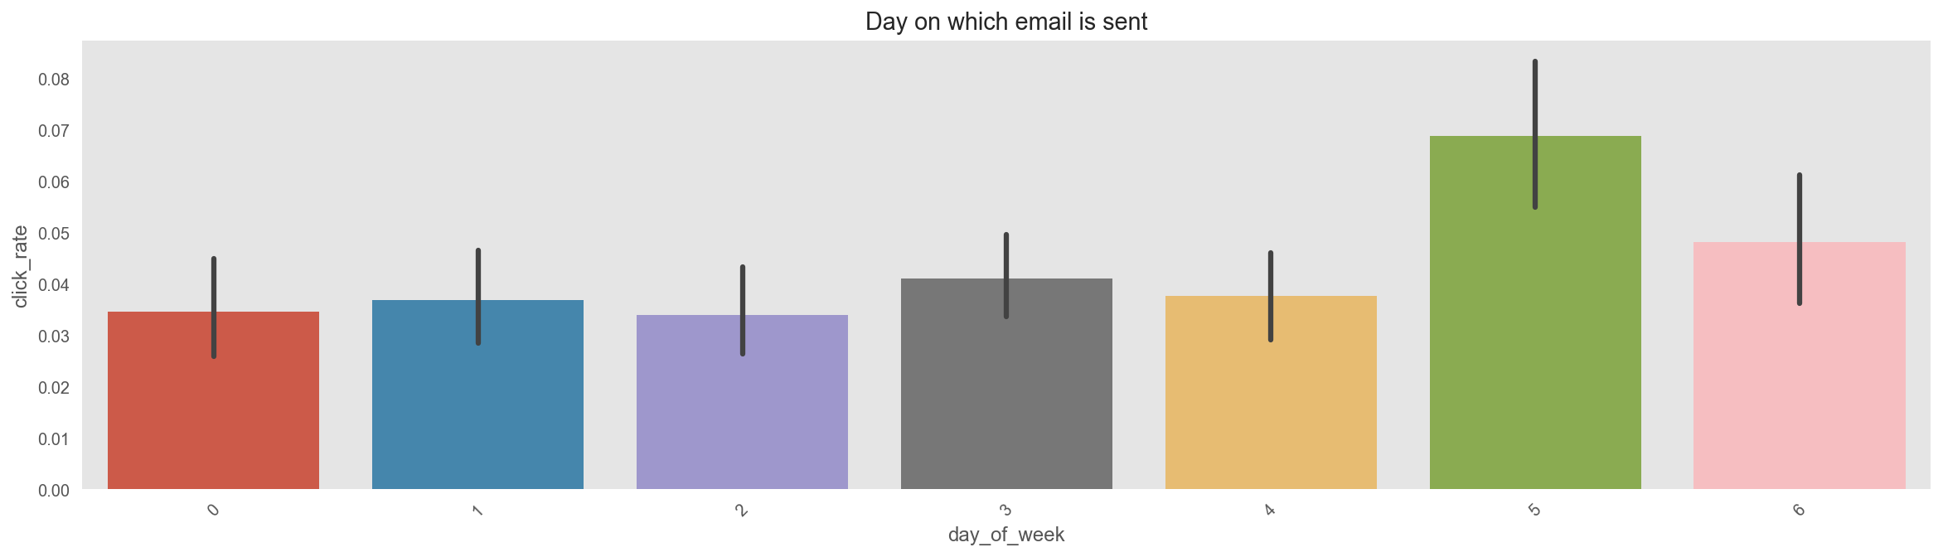
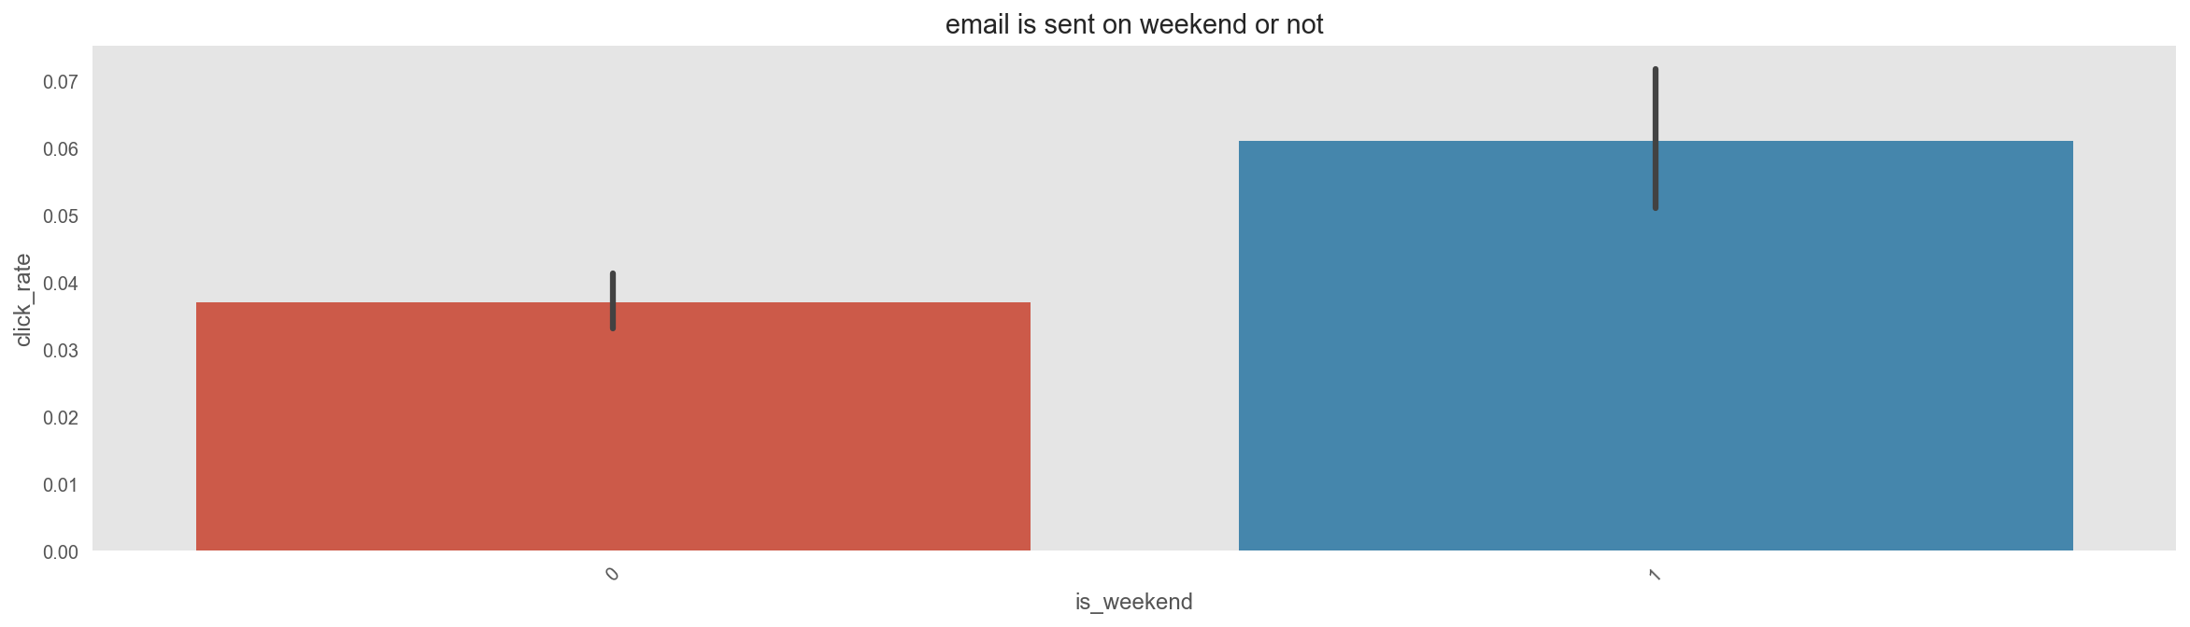
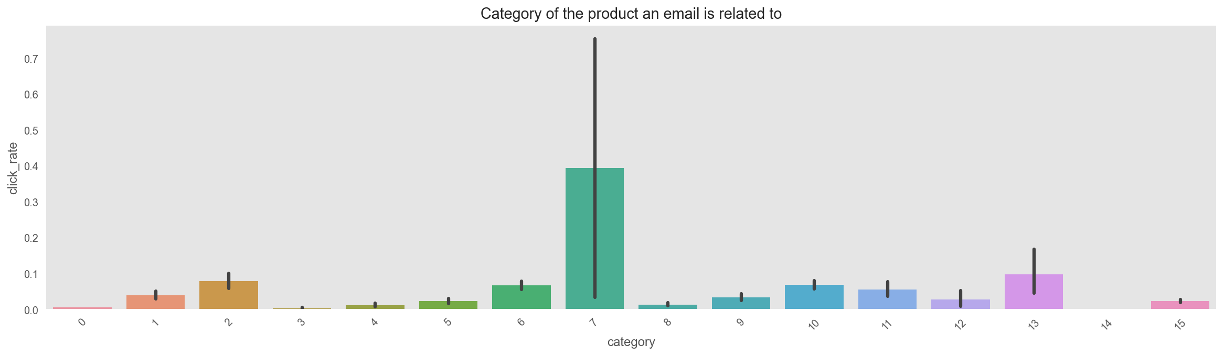
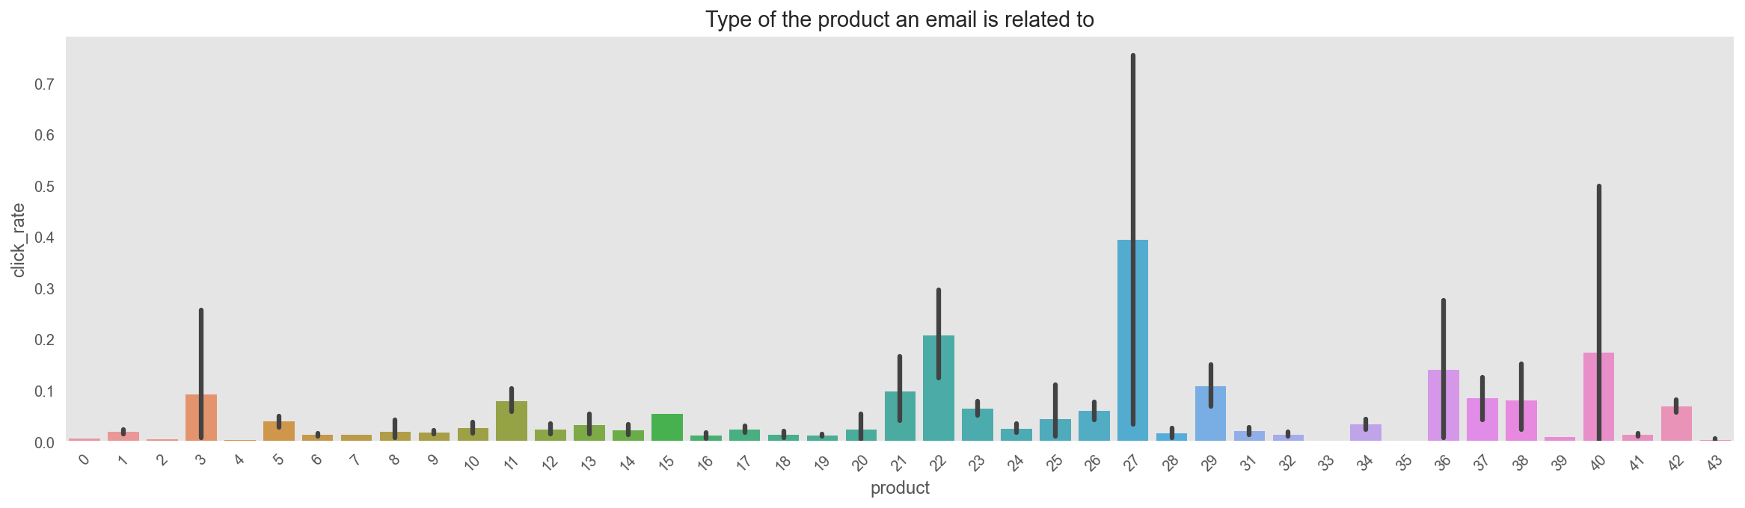
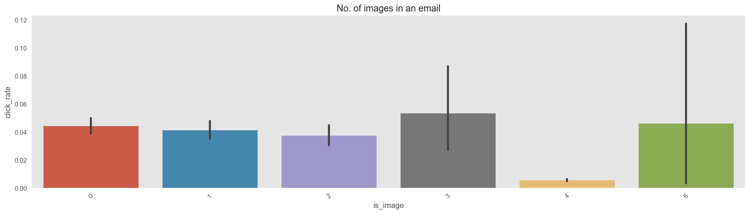
DATA PROCESSING- FEATURE EXPLORATION ON BAR PLOT
Inference:
Inference:
Inference:
The grouping of the sender are divided into 12 parts.
On each different part we can see if sender of an email is 7 we can get a good click_rate.
From the below bar plot if the email is sent on 5th day or the 6th day we can get good click rate.
So yes, if the email is sent on weekend we are sure to get a good click_rate. That's what we have seen under the day of week as well..
Add Text
Simple PowerPoint Presentation
Inference:
Inference:
Inference:
If the product of an email is related to 27th the click_rate will be high. Than on 22nd, 36th and 40th product we can get good amount of click_rate. The company should focus on these product to get good click_rate from the customer.
On an average we can get good click rate except for the no of image is 4, we need to find why they are not giving us good result may be because of body len or some other factors. The company should change the structure of the email if it consists the 4 image to more fascinate the customer.
If the product is related to 7th category we can get good click_rate.

Slide 13
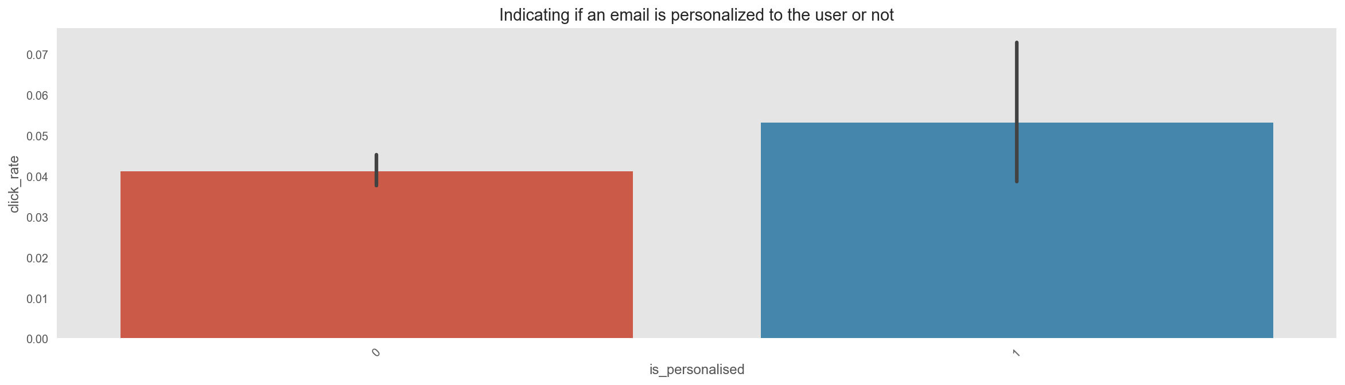
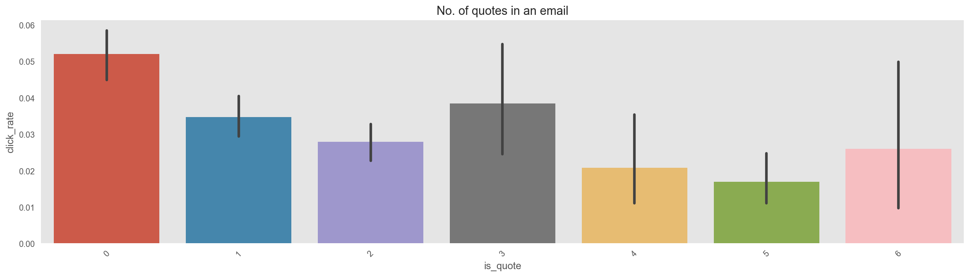
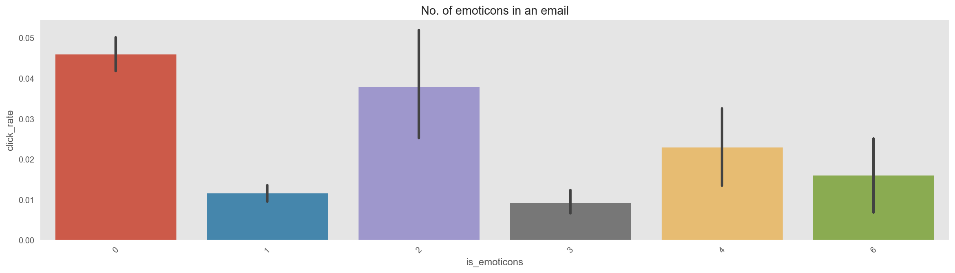
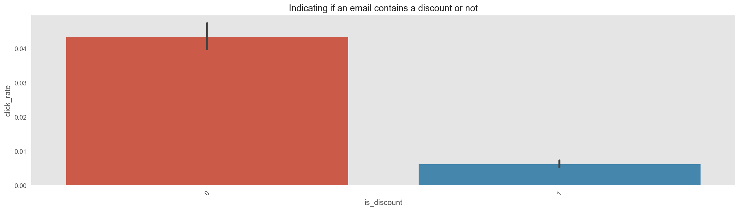
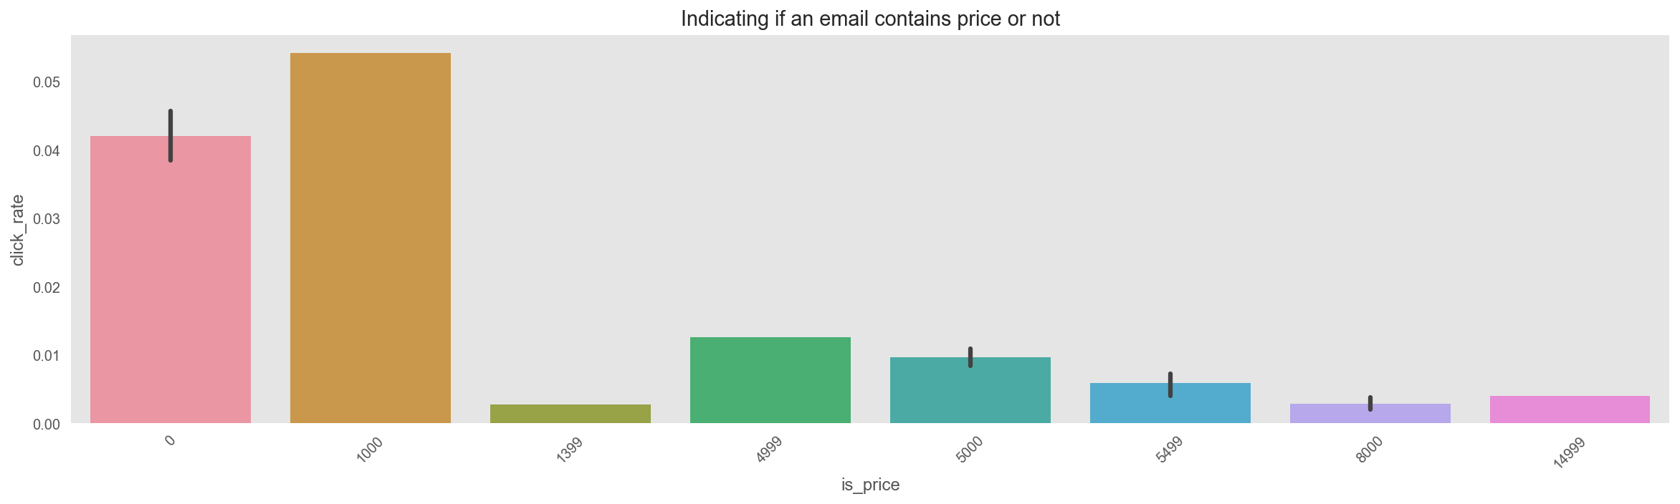
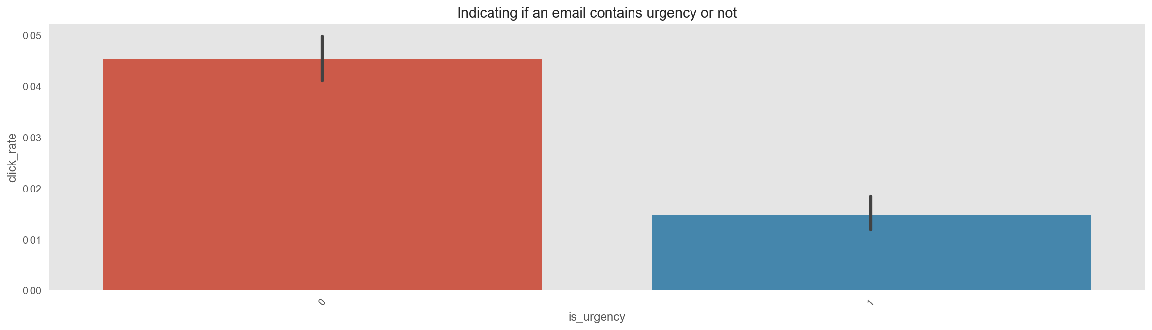
DATA PROCESSING- FEATURE EXPLORATION ON BAR PLOT
Inference:
Inference:
Inference:
So the customer are keen towards there personalised email, this is the nature of human being the things interested to them will be good for the company.
Everything has been gone to worse, as i was thinking if there are more quote the people will enjoy more, but here its totally different the less the quotes in the email we can get good click_rate..
If the no. of emoticons in the email are nill thats good for us, by looking at the barplot we can say we need to be on average to get good click rate
Add Text
Simple PowerPoint Presentation
Inference:
Inference:
The barplot shows if the discount is not there in the email we can get very large click_rate. But to my personal thinking who don't like discount everybody does, the company needs to again recheck the data from the campaign.
As per the variable description we are told the price is in boolean but the data consist price under different range, If the email consist of the price the click rate will be high.
Inference:
If the email doesn't consist urgency we can get higher click rate.

Slide 14
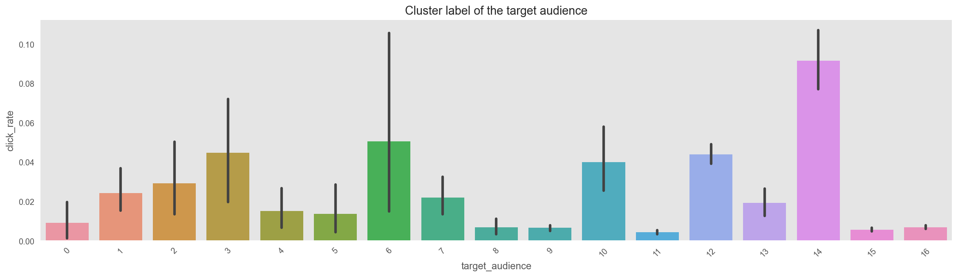
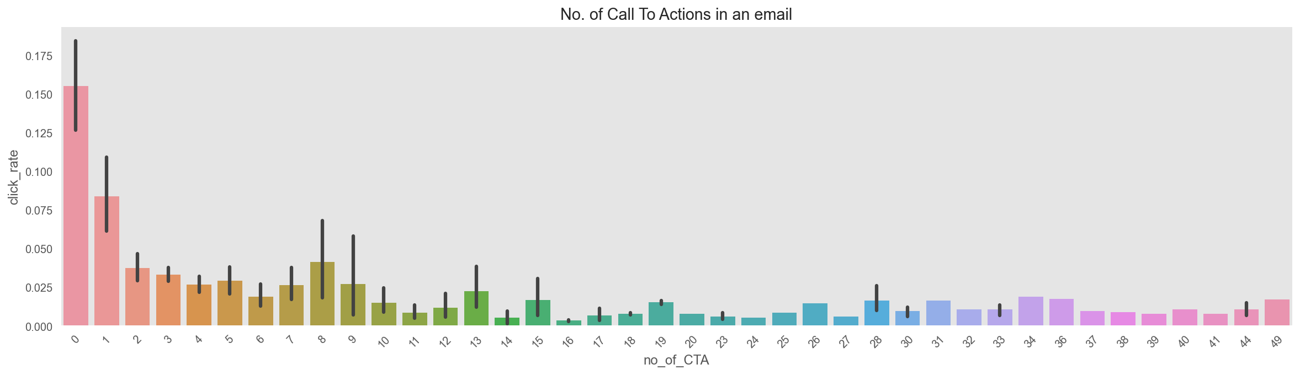
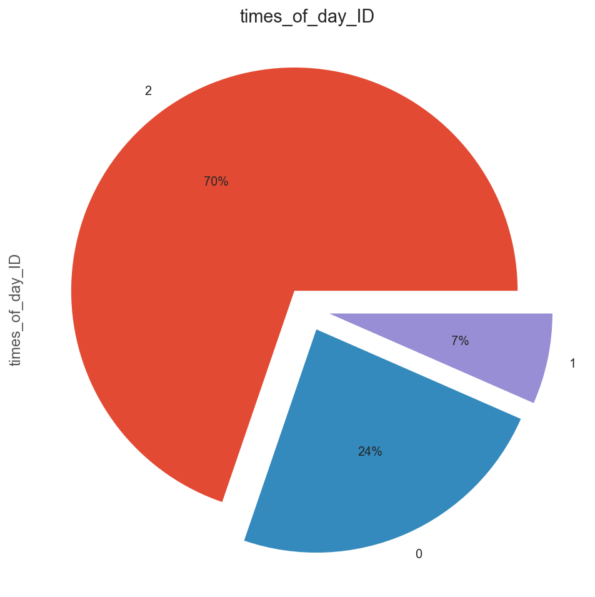
DATA PROCESSING- FEATURE EXPLORATION ON BAR PLOT
Inference:
Inference:
Inference:
The cluster label of the target audience is 14 they are giving us good click rate.
If the no of call to action in an email is less the click_rate is high.
0 represent Noon, 1 represent Morning, 2 represent Evening. From the above pie chart if the email are sent in the evening the click rate is high.

Slide 15
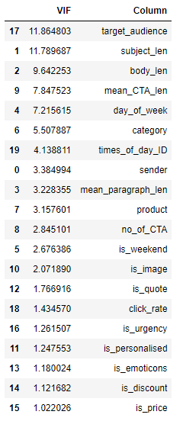
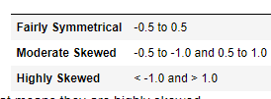
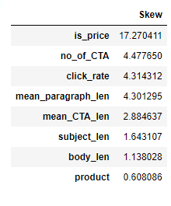
DATA PROCESSING- Checking Skewness With Original Numerical Features
Calculate The VIF Value For Multicollinearity Check
Inference:
Inference:
As rule of thumb, skewness can be interpreted as below.
All the numerical feature which are greater than 1.0 that means they are highly skewed.
As we can see from above, almost top six variables have a VIF value above 5. To remove multicollinearities, we can do two things. We can create new features or remove them from our data. But over here we will keep this as it is as the multicollinearities are ok.

Slide 16
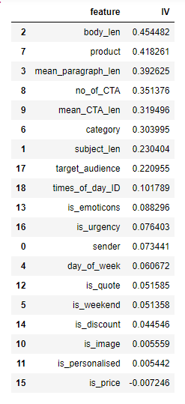
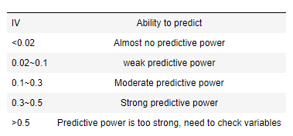
DATA PROCESSING- INFORMATION VALUE (IV)
Inference:
Information Value (IV) is calculated for all features in the extended dataset in order to estimate their potential contribution to detectability
This is an indicator of feature quality and reasoning for feature selection
Is_image, is_personalised & is_price are having very less predictive power we can either remove them or use it in our model..

Slide 17
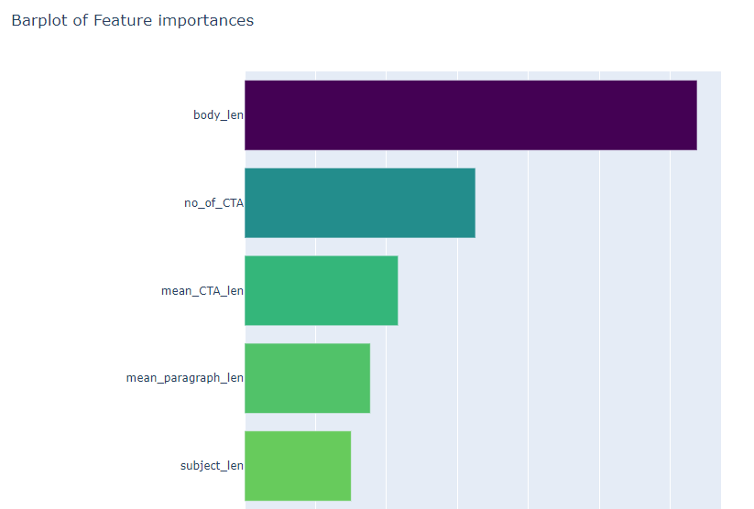
DATA PROCESSING- Feature Importance using Random forest
Inference:
While comparing the Information value and feature importance, some of the variables are very important for model building

Slide 18


04
MODEL
BUILDING

Slide 19
Different Model For Regression
ML models Used For Regression
1. Linear Regression
7. DecisionTree Regressor
2. RANSAC Regressor
8. RandomForest Regressor
3. Ridge
9. SVR
4. Lasso
10. XGB Regressor
5. ElasticNetCV
11. GBoostReg
6. SGD Regressor
12. LGBM Regressor

Slide 20
Checking Model Accuracy
Mean Squared Error (MSE)
Mean Squared Error (MSE) is the mean of the squared errors:
Mean Absolute Error (MAE)
Mean Absolute Error (MAE) is the mean of the absolute value of the errors:.
R2 Score
It works by measuring the amount of variance in the predictions explained by the dataset.If the value of the r squared score is 1, it means that the model is perfect and if its value is 0, it means that the model will perform badly on an unseen dataset
Root Mean Squared Error (RMSE)
Main
Root Mean Squared Error (RMSE) is the square root of the mean of the squared errors:
MAE is the easiest to understand, because it's the average error. MSE is more popular than MAE, because MSE "punishes" larger errors, which tends to be useful in the real world. RMSE is even more popular than MSE, because RMSE is interpretable in the "y" units. All of these are loss functions, because we want to minimize them..

Slide 21
Building ML Model Flow
A
C
B
D
A
Model1- Simple Machine Learning Algorithms
B
Model2- Cross Validation Technique On ML Algorithms
C
Model3- Stacking model
D
Model3- Blending Model

Slide 22

Model1- Simple Machine Learning Algorithms
Inference:
We can say the best working model by loking R2 the best working model is Random Forest Regressor. Its MAE is also less.

Slide 23


Model2- Cross Validation Technique On ML Algorithms
Inference:
Applying the Stratified K-fold Cross-Validation technique, helped us to predicting the best model but we need much more better accuracy.
RMSE mean need to be more lower down.

Slide 24

Model3- Stacking model
Inference:
Stacking consider heterogeneous weak leaner prediction. Learn them in parallel and combine them by learning meta learners to output prediction based on different weak learner's.
Ensemble methods use multiple learning algorithms to obtain better predictive performance than the learning algorithm alone. Stacking model is an ensemble one.
Stacking: Stacking-type ensemble where the meta-model is trained on out-of-fold predictions made during k-fold cross-validation
The model had predicted quite well with this technique. We have got better r2Score and the least RMSE value.

Slide 25

Model3- Stacking model
Inference:
Blending is an ensemble machine learning technique that uses a machine learning model to learn how to best combine the predictions from multiple contributing ensemble member models.
Blending Ensemble: Use of a linear model, such as linear regression or logistic regression, as the meta-model in a stacking ensemble.
Blending Stacking-type ensemble where the meta-model is trained on predictions made on a holdout dataset.
Very nice we got the Accuracy of 85% in r2score. Which is the highest of all. We will finalize this model for test dataset.

Slide 26

05
Drawing Conclusion - Summary

Slide 27
Drawing Conclusion - Summary
What kind of problem are we trying to solve?
The problem that we are given is to predict CTR (Click Through Rate) of an email campaign. This help the organization to see is there users are responding or not. It act as a relationship between them. So, the business objective is how to increase the CTR and predict the CTR.
The dtypes for our variables are numerical and categorical. Some of the dtypes provide are not in Boolean for them we have to convert them to bolean structure.
We have first checked the statistical details of the variable and we got to know that many of the variables averageare near to zero. The variables contain to much of outliers as the max and median has quite distance in it.
For feature engineering we have drop of the campaign_id as they are not important to us. We have also drop the is_timer column as the value consists in it zero both train and test data. We have encoded times_of_day and saved in times_of_day_ID. As that will help model to predict on the basis of categorical. ‘is_price’ column given to us was not in Boolean so we converted it Boolean.
While seeing the correlation of target variables with others there is no high correlation we got. That means target variable have week linearity with others.
Strong correlation is there between no_of_CTA and body_len, subject_len is moderately correlated with body_len and no_of_CTA.
mean_paragraph_len is highly negative correlated with body_len.
We have explore the feature on the distplot and box plot and got that the variables are not normally distributed and they have to much of outliers.
So, our task is to make the distribution normal so that the outliers can also come near to the mean. As there are a lot of outliers and we cannot remove them nor we can adjust them as the dataset is also to small, doing so will drastically change our prediction.

Slide 28
Drawing Conclusion - Summary
With the regplot we came to know that only mean_paragraph_len' & 'product' are giving linear relation as it increases with the target variables. Many of the variables are negatively related to target variables. So it will be difficult for us to predict.
Through Bar plot feature exploration on different variables compared with target variables. Most of the variables are averagely good for CTR. The bar plot helped us to know how to use each and every variable to get more CTR.
As our dataset is having to many outliers so we have produced a skewness table to know how each of the variables is highly skewed.
VIF help us in detecting multicollinearity. But we are not trying to remove the feature as our evaluation matrix is R2 and in r2 if there are more and more features it will help us in good scoring. Also many of the machine learning algorithms don’t get affected by multicollinearity.
We have also produced the WOE. WoE helps check the linear relationship of a feature with its dependent feature to be used in the model. IV is a good measure of the predictive power of a feature and it also helps point out the suspicious feature. Some of our variable IV value is too low, we will remove them if our model don’t predict the good accuracy value. But now we will keep it and we will solve this with Cross Validation techniques.
We have used multiple models for predicting the regression. We have also used different hyperparameter techniques. Hyperparameters maximize the model's performance, minimizing a predefined loss function to produce better results with fewer errors. We have used different hyperparameter values as they cannot be defined which is best or better so we have changed it a lot of times to get a better result.
In our first Model1 we don’t get a good evaluation value of r2. although we have just used simple techtics.
Under cross validation Model2 everything has changed, we have used kfold for the model validation technique. Cross-validation is a resampling procedure used to evaluate machine learning models on a limited data sample. The procedure has a single parameter called k that refers to the number of groups that a given data sample is to be split into.

Slide 29
Drawing Conclusion - Summary
On cross-validation we got to know that which of our model is giving us best result so that we can use it for further processing.
Next after getting to know each model we used Stacking techniques Stacking enables us to train multiple models to solve similar problems, and based on their combined output, it builds a new model with improved performance. Well, the ultimate goal of stacking is a smaller risk of overfitting. It helps us to characterize the different models. It help us to make a weak model strong and a strong one more predictable.
Lastly, why I have used the blending technique? Well, Blending is an ensemble machine learning technique that uses a machine learning model to learn how to best combine the predictions from multiple contributing ensemble member models. And as we know Ensemble methods have higher predictive accuracy, compared to the individual models. Ensemble methods are very useful when there is both linear and non-linear type of data in the dataset; different models can be combined to handle this type of data.

Slide 30

Any questions? You can find me at:
rahulsingh409@gmail.com
Github Link
Linkedin
Thanks!

